Slide 1
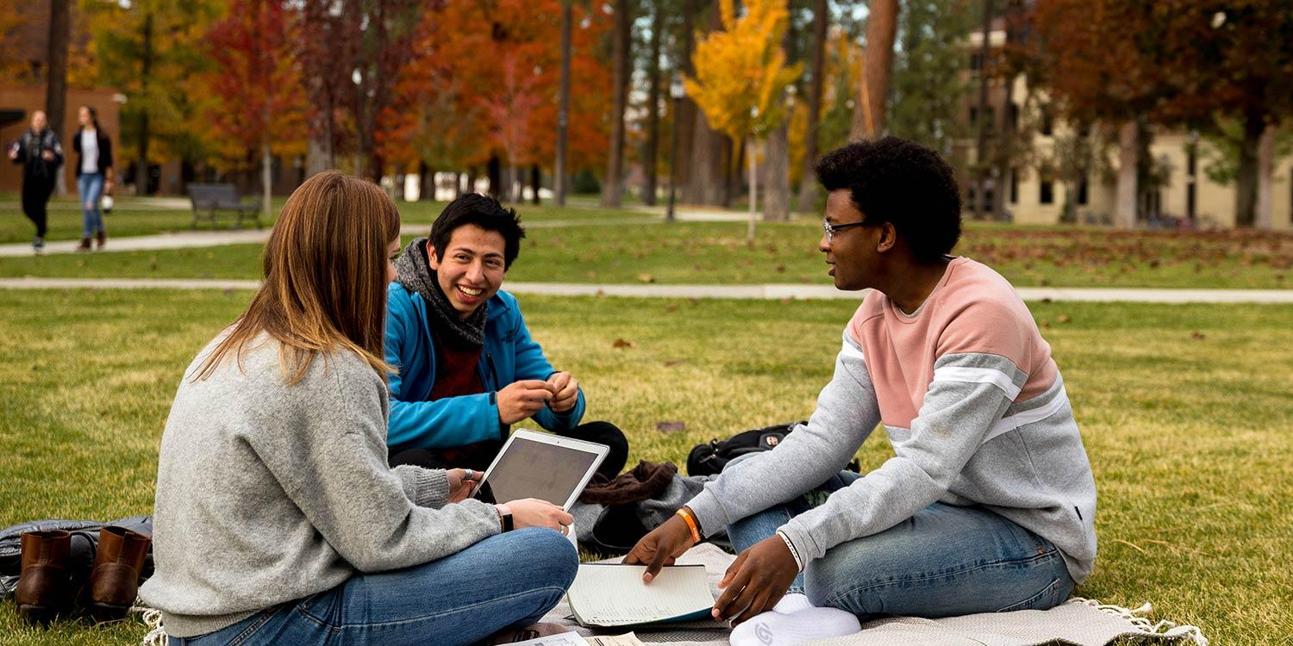
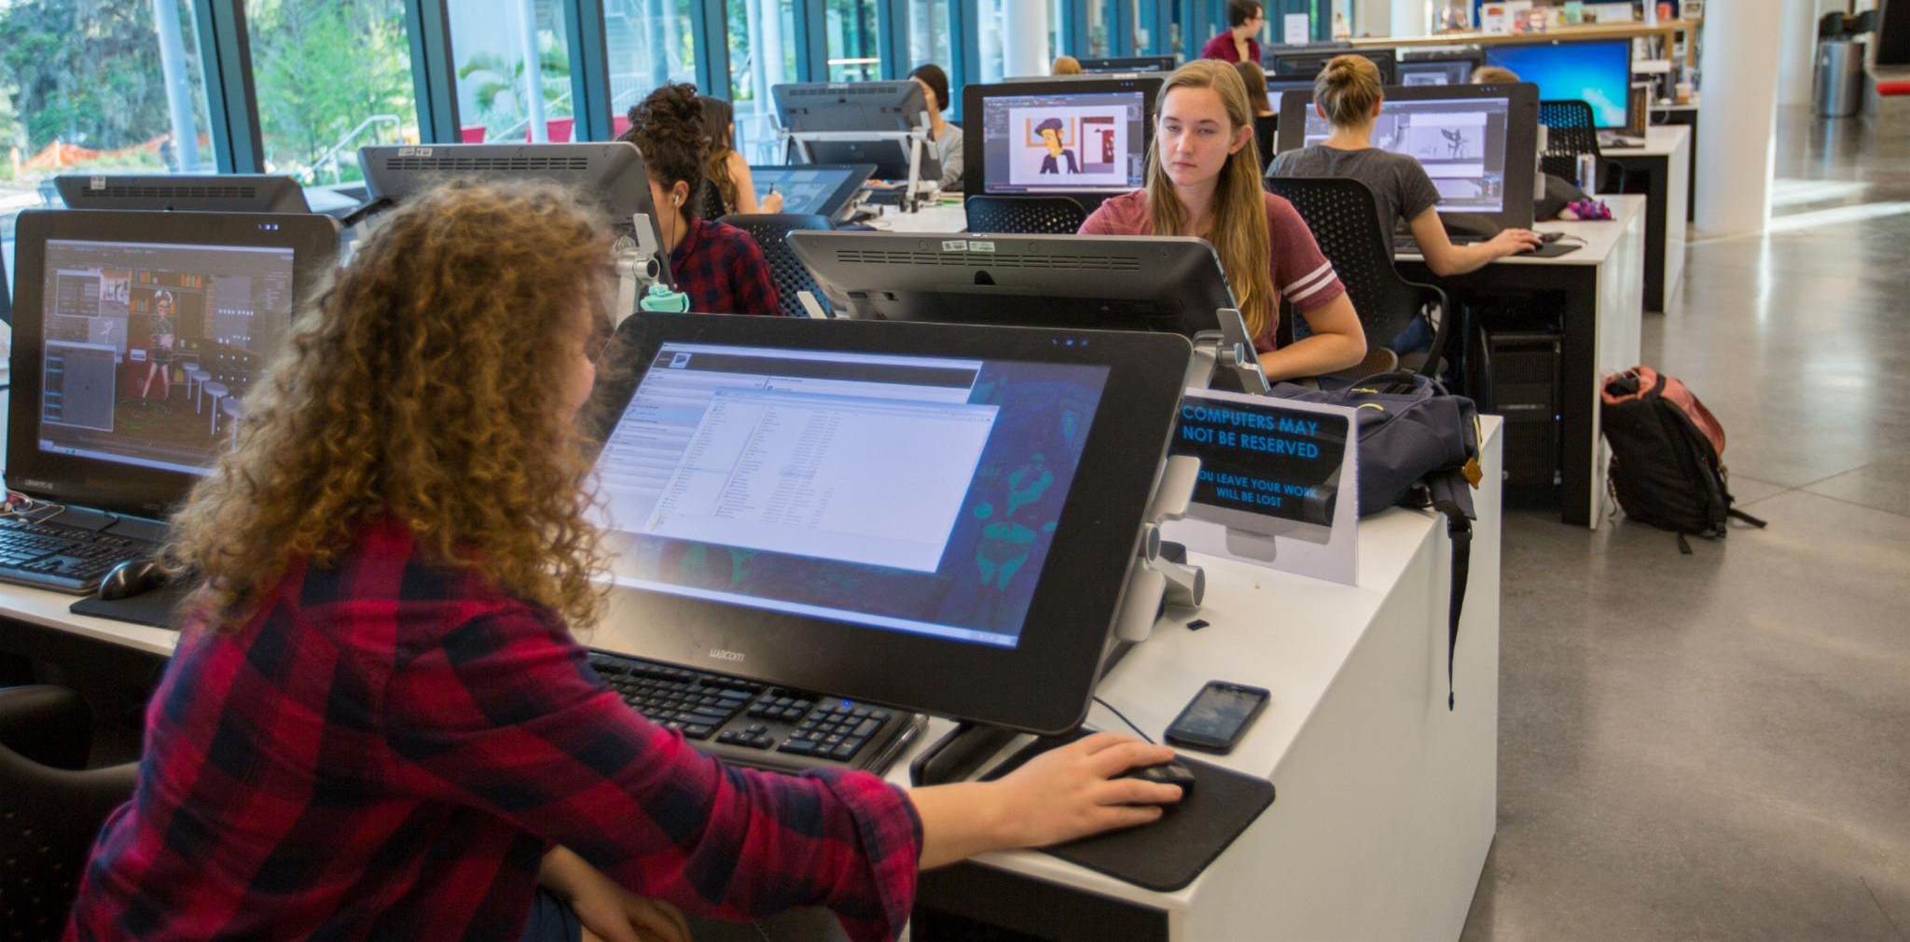


CollegeCommunity
Whether you know what you want
(or don’t)
CollegeCommunity has got you!
what we’re here for!
by Allison Fisher, Maryia Kalodkina, Maya Srinath

Slide 2
OUR MISSION
WHAT WE ARE
CollegeCommunity offers a seamless platform delivering custom mentorship based on the user’s academic and co-curricular interests.
Make planning for college insightful as ever by integrating real experiences and communication to help students find their ideal college community and mentor.
Why CollegeCommunity?
Real people, real experiences
Custom Mentorship

Slide 3
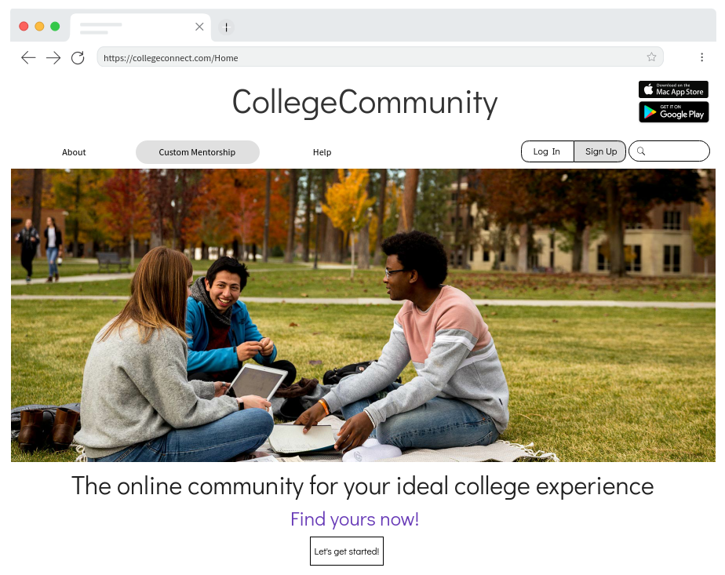
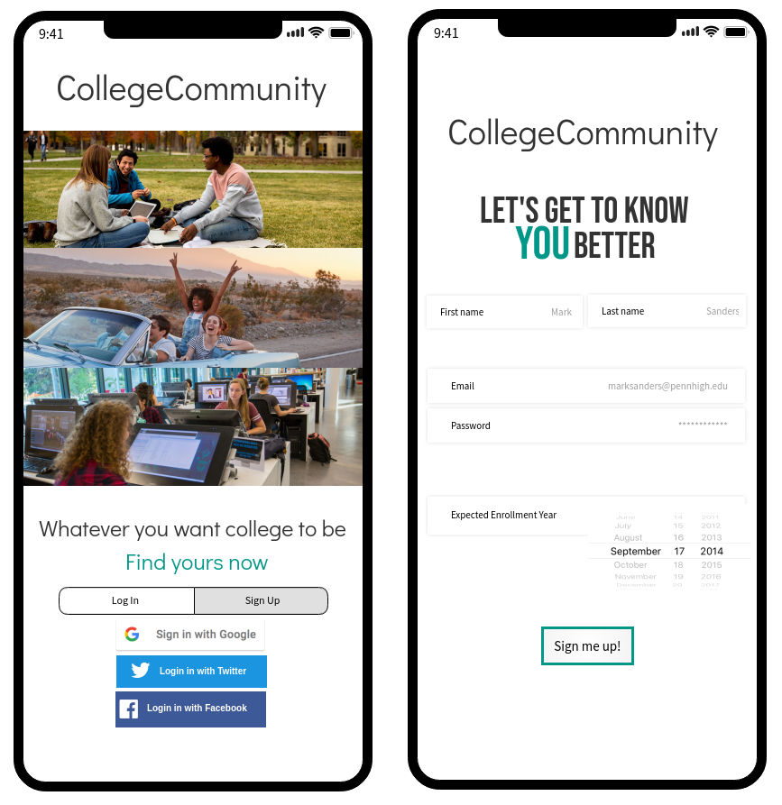
WEBSITE AND MOBILE

Slide 4
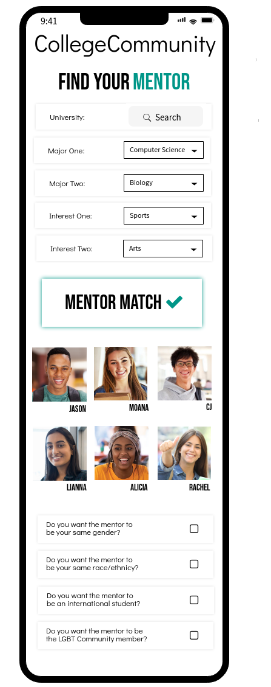
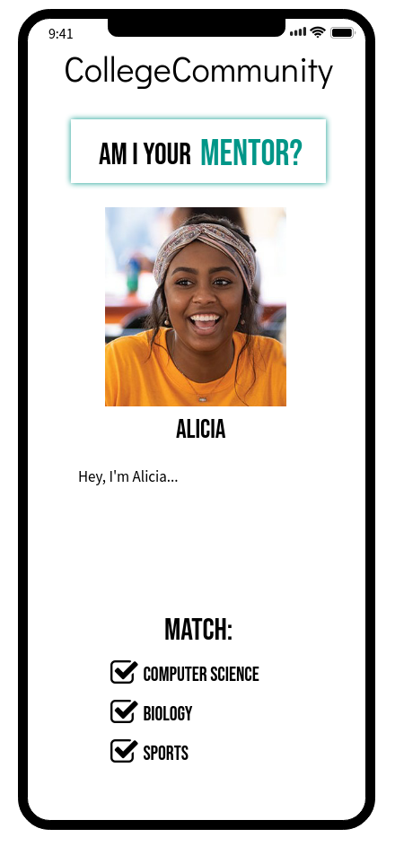

Slide 5
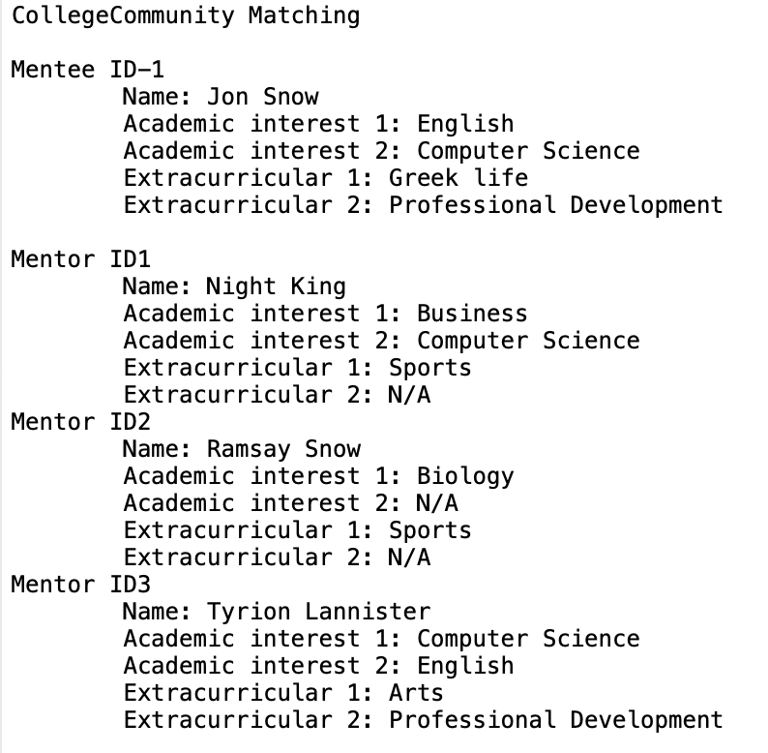
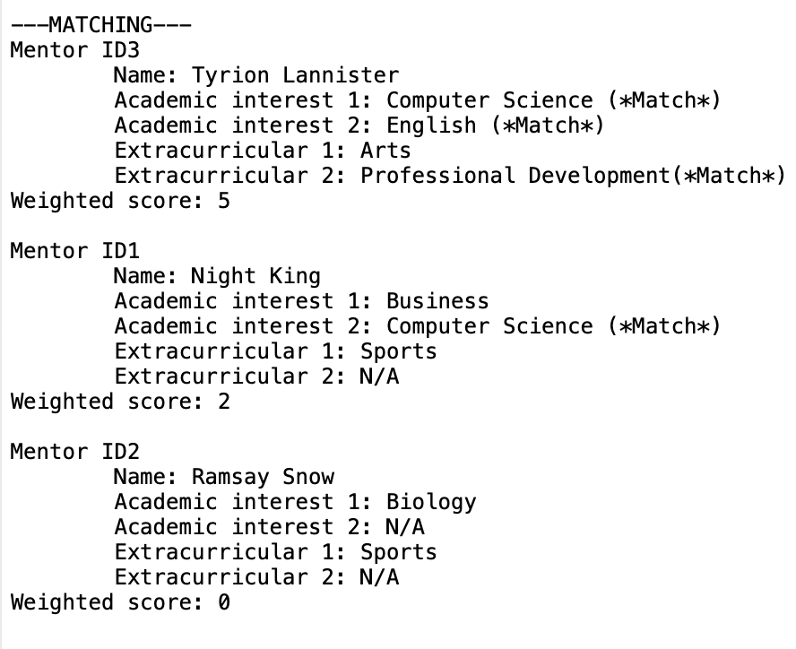

Slide 6

THANK YOU!
Questions?

